Slide 1
“Data Analysis in SQL & Python”
By
Hemant Gupta
Email- hemantgupta0801@gmail.com
LinkedIn- https://www.linkedin.com/in/hemant-gupta-4914baa6

Slide 2
Data Preprocessing
Data Analysis Process
Data Import and Quality Check
Import the CSV file into MySQL Workbench.
Perform data quality checks, such as:
Replacing null values.
Modifying data types.
Removing duplicates.
Standardizing formats (e.g., dates) using SQL queries.
Data Cleaning and Export
After cleaning the data in MySQL Workbench, export the cleaned file as a CSV for further analysis.
Data Visualization
Load the cleaned CSV file into Python to generate visualizations and insights.
Initial Data Understanding
Upon first examining the data, I identified that it is sales-related.

Slide 3
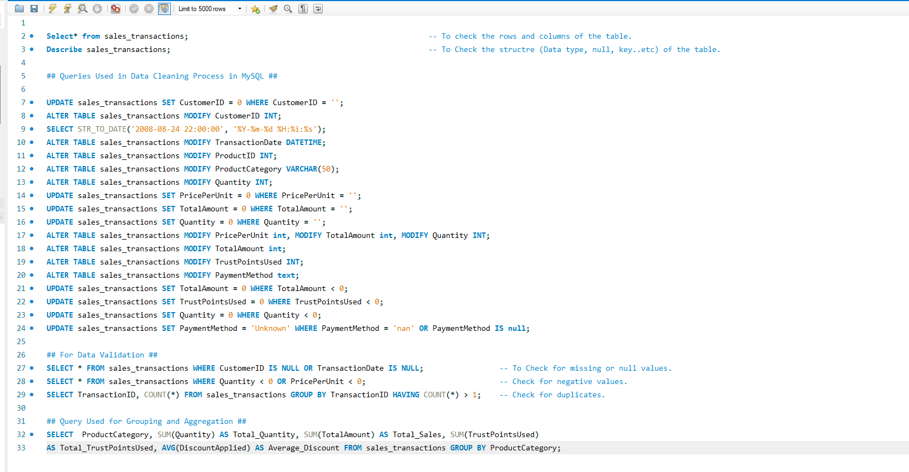
Queries used in Data Cleaning

Slide 4
Data Aggregation and Grouping
Fields for Aggregation:-
Quantity: Can be summed up to analyze total products sold.
Price Per Unit: Can be averaged to understand price distribution.
Total Amount: Can be summed up for total revenue calculations.
Discount Applied: Can be averaged to gauge discount trends.
Trust Points Used: Can be summed to analyze customer loyalty usage.
Aggregation Methods and Justification:-
Sum (for Quantity, Total Amount, Trust Points Used): Summing these fields helps in understanding overall totals.
Average (for Price Per Unit, Discount Applied): Averaging these fields provides insight into general pricing and discount trends.
Query Used for Aggregation:-
SELECT ProductCategory, SUM(Quantity) AS Total_Quantity, SUM(TotalAmount) AS Total_Sales, SUM(TrustPointsUsed) AS Total_TrustPointsUsed, AVG(DiscountApplied) AS Average_Discount FROM sales_transactions GROUP BY ProductCategory;

Slide 5
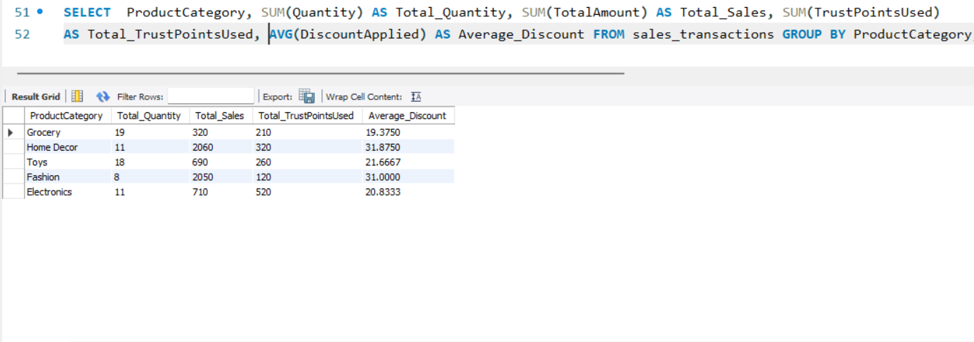
Output of query used for Aggregation in MySQL

Slide 6
Data Validation
Consistency Checks-
Cross-checked raw data against cleaned data to ensure accuracy.
Key Validation Rules-
Verified that each transaction contains a valid:
Customer ID.
Transaction Date.
Non-negative Quantity and Price per Unit.
Ensured Data Integrity-
Confirmed that no duplicate Transaction IDs exist.
Validation SQL Queries:-
Check for Missing or Null Values:
SELECT * FROM sales_transactions WHERE CustomerID IS NULL OR TransactionDate IS NULL;
Check for negative values
SELECT * FROM sales_transactions WHERE Quantity < 0 OR PricePerUnit < 0;
Check for duplicates
SELECT TransactionID, COUNT(*) FROM sales_transactions GROUP BY TransactionID HAVING COUNT(*) > 1;

Slide 7
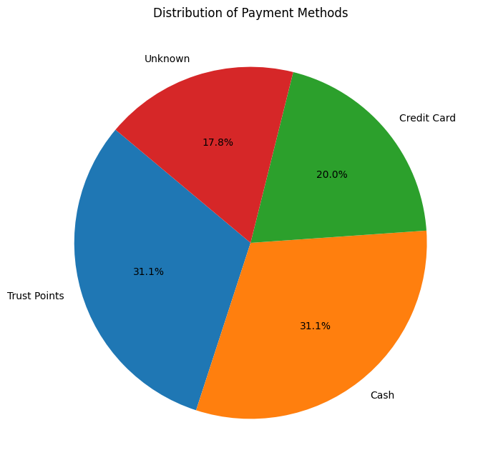
Data Visualisation using Python
Pie Chart: Proportional analysis of payment methods used.
Code –
import pandas as pd
import matplotlib.pyplot as plt
import seaborn as sns
df = pd.read_csv('Sales_transactions_CleanData.csv’)
# Pie Chart: Payment Methods Distribution
payment_methods = df['PaymentMethod'].value_counts()
plt.figure(figsize=(8, 8))
plt.pie(payment_methods, labels=payment_methods.index, autopct='%1.1f%%', startangle=140)
plt.title('Distribution of Payment Methods')
plt.show()

Slide 8
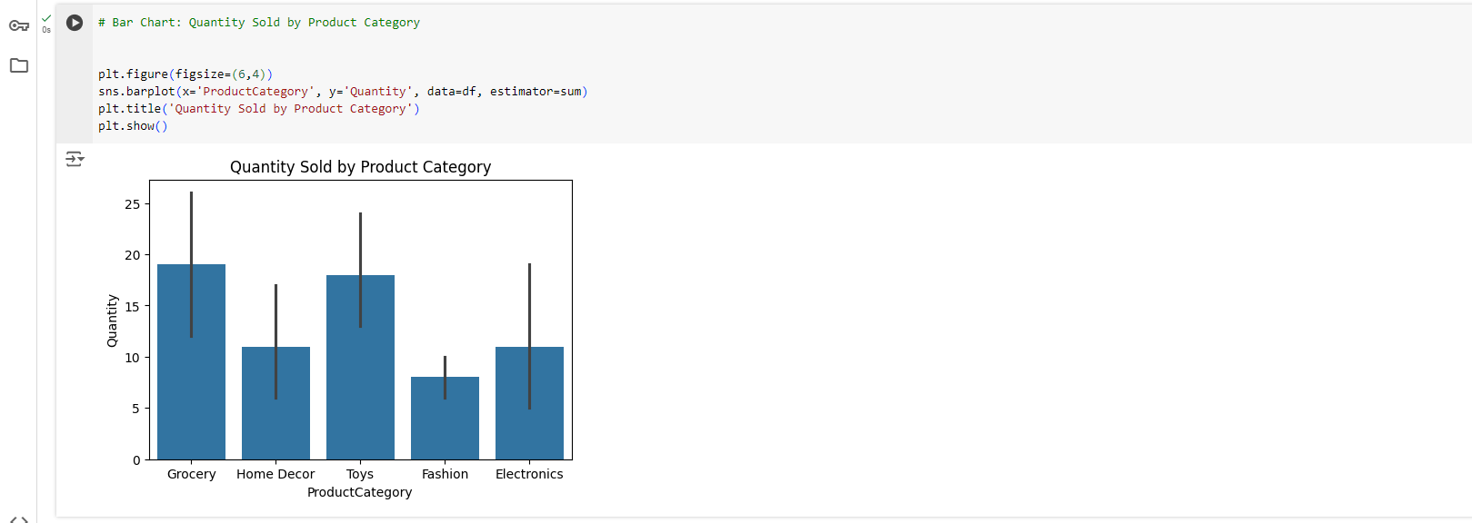
Quantity Sold by Product Category

Slide 9
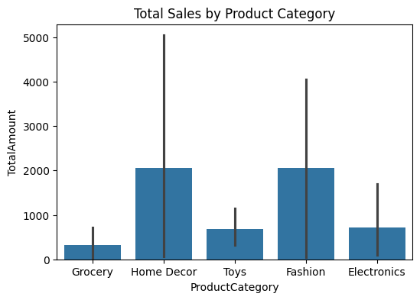
Total Sales by Product Category
Code-
plt.figure(figsize=(6, 4))
sns.barplot(data=df, x='ProductCategory', y='TotalAmount', estimator=sum)
plt.title('Total Sales by Product Category')
plt.show()

Slide 10
Thank You

